Slide 1

LSL Part 1:
Overview
David Medine 20/10/2021

Slide 2

Preamble
All materials presented are available for download on github:
https://github.com/Diademics-Pty-Ltd/BrainProducts_BCI_Event

Slide 3
What Is LSL?

Slide 4
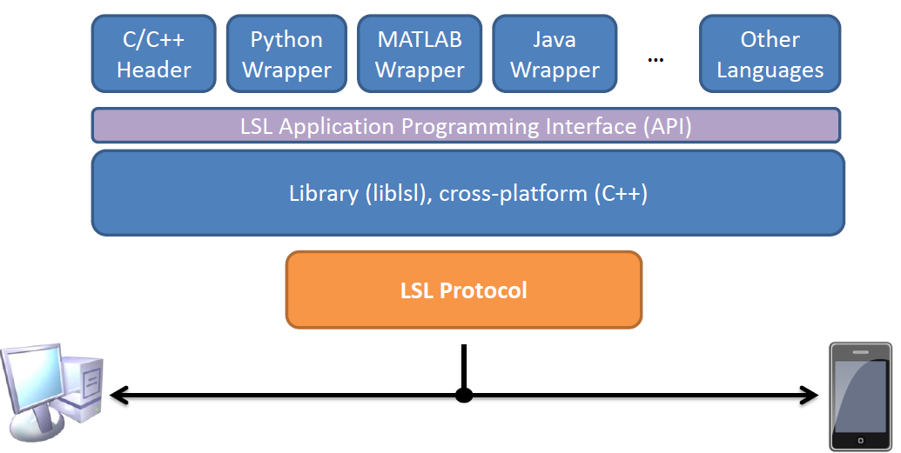
What Is LSL?
LabStreamingLayer (LSL) is a network protocol and set of programming tools for bio-physiological signal streaming, recording, and synchronization.
Courtesy of Christian Kothe

Slide 5
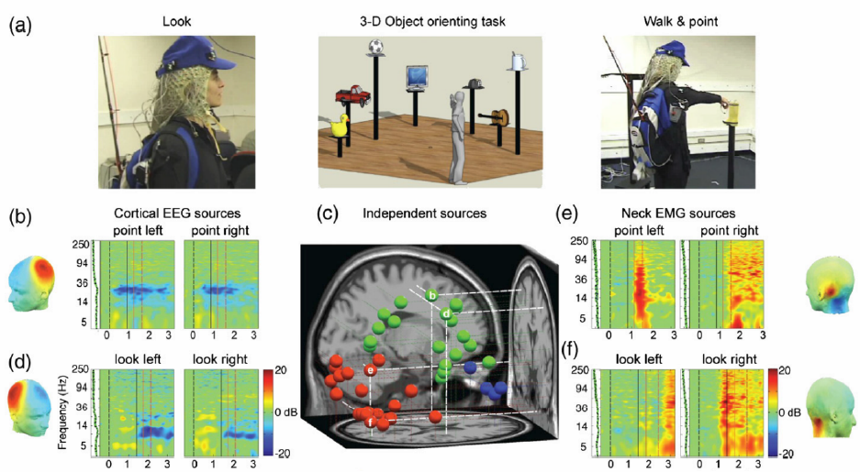
What Is LSL?
LSL was originally authored by Christian Kothe in 2012 at the Swartz Center for Computational Neuroscience (University of California, San Diego).
Courtesy of Klaus Grammann
LSL was designed to solve problems associated with Mobile Brain/Body Imaging.

Slide 6
What Is LSL?
LSL attempts to solve a wide range of problems.
Format mess
lots of file formats and importer/conversion functions
custom scripts needed to read/write extra files
missing or unreadable meta-data (e.g. channel labels)
Complex hardware time synchronization ...
a lot of custom hardware and cabling
easy to make mistakes at collection time
lengthy setup
... or brittle and wacky post-hoc synchronization
e.g. compare file times for different simultaneous recordings
find and match peaks in different signals

Slide 7
What Is LSL?
Error prone data collection
chance of failure increases with the number of devices, computers, programs and data files
should be able to reconnect or hot-swap during experiment
No unified tools for recording, viewing, etc.
Every vendor has a different API (or none)
Not very easy to get data out of most hardware

Slide 8
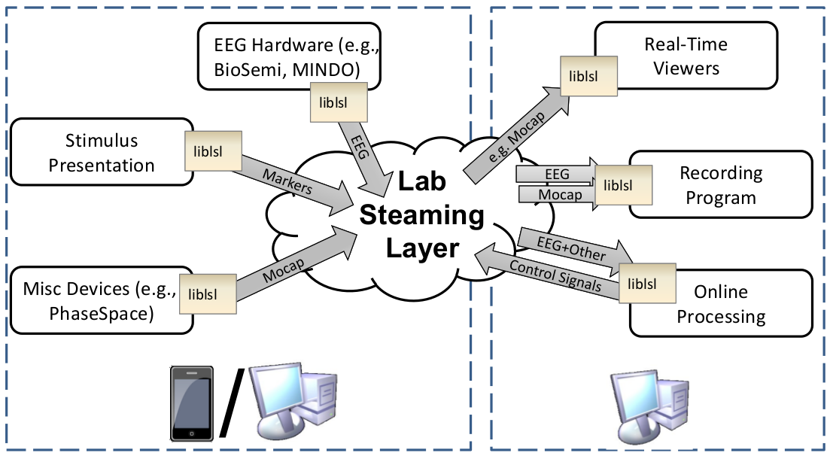
What Is LSL?
LSL
Courtesy of Christian Kothe

Slide 9
What Is LSL?
LSL has an associated data file format called the eXtensible Data Format (XDF).
Some features of XDF:
All data streams (including Markers) are stored in a single file.
All meta-data is stored as XML in the same file together with the data.
All information necessary for synchronizing the data is stored in the same file together with the data and the meta-data.
There are XDF readers in Matlab (and EEGLAB), Python, and Julia.
Load settings are quite flexible, but 99% of the time, default settings will provide you with everything you need (analysis scripts are highly re-usable).

Slide 10
What Is LSL?
In the last decade, LSL has grown immensely:
The github repository (as of this week) gets ~40 clones and ~2000 views/week
The underlying C++ library is actively maintained to conform to modern standards as are most of the over-lying language interfaces.
LSL is used not only by academic scientists but also by researchers for institutions such as NASA and Facebook
There are nearly 100 (known) supported hardware devices listed on the LSL documentation page.

Slide 11
What Is LSL?
Why would I need LSL?
LSL provides the following:
a standardized protocol to stream data reliably from device to device
built in synchronization functionality
APIs in many popular programming languages
pre-compiled binaries of most apps
thorough documentation, many example programs, active developer community

Slide 12
What Is LSL?
Summary:
LSL was created specifically to solve the problem of reliably and easily collecting and synchronizing multi-modal data.
But, LSL was also made to be a general-purpose data-streaming service.
BCI applications were always part of LSL’s intended use.

Slide 13
Where Can I Get LSL?

Slide 14
Where Can I Get LSL?
Some important links:
The labstreaminglayer master repository: https://github.com/sccn/labstreaminglayer
The Brain Products LSL connector repositories: https://github.com/brain-products
The XDF repository: https://github.com/sccn/xdf
LSL Readthedocs: https://labstreaminglayer.readthedocs.io/info/getting_started.html
Brain Vision LSL Viewer: https://www.brainproducts.com/downloads.php?kid=40&tab=3

Slide 15
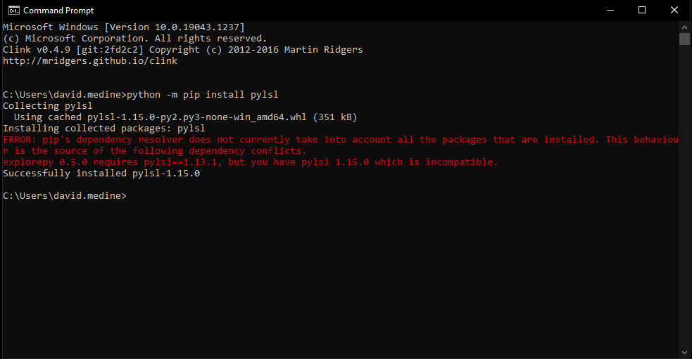
Where Can I Get LSL?
The LSL Python API is available via pip:

Slide 16
Where Can I Get LSL?
The rest of the LSL APIs need to be downloaded from github:
https://github.com/sccn/labstreaminglayer/tree/master/LSL
We would like to make liblsl-Csharp available via nuget, but this is a bit tricky (also I want to complete overhaul the API at some point).
(Walkthroughs for getting started with liblsl, liblsl-Python, liblsl-Matlab, and liblsl-Csharp)

Slide 17
What Can be Done with LSL?

Slide 18
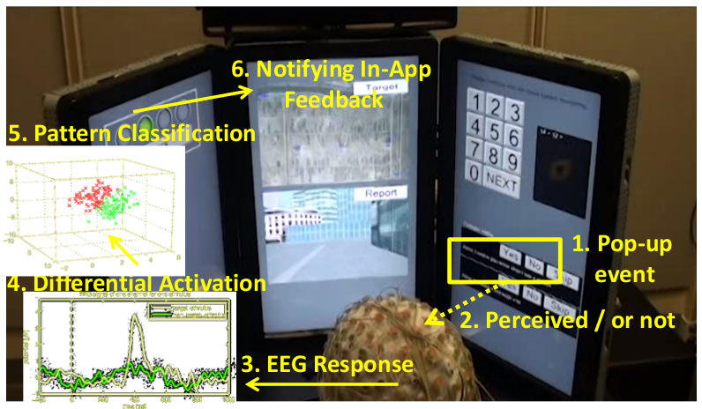
What Can be Done with LSL?
The Large Scale Experiment:
A multi-player, highly complex cooperative driving task to investigate the feasibility of running classic BCI classifications in a ‘real-world’ scenario.
Shih, Victor, et al. "Predicting decision accuracy and certainty in complex brain-machine interactions." 2016 IEEE International Conference on Systems, Man, and Cybernetics (SMC). IEEE, 2016.
Courtesy of Christian Kothe

Slide 19
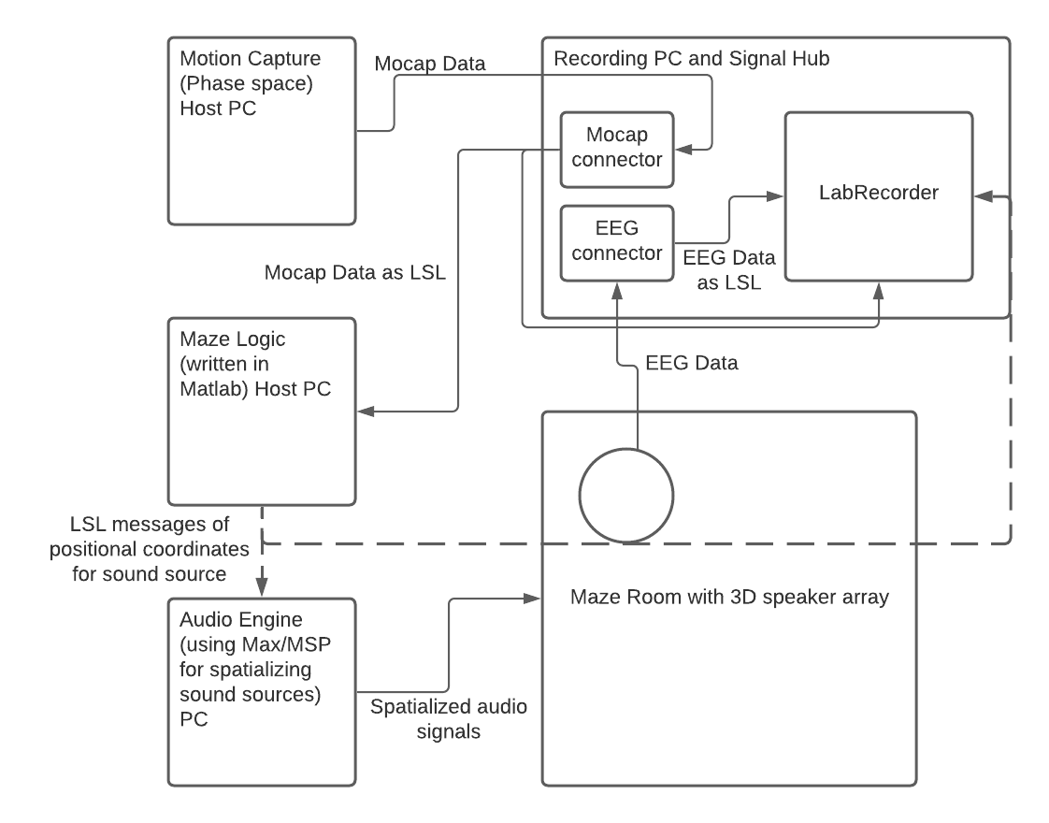
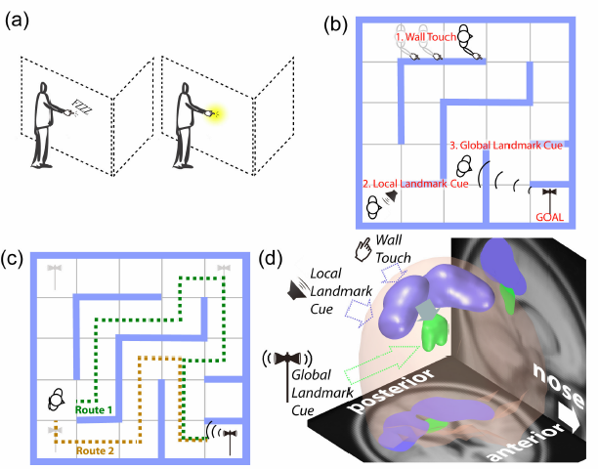
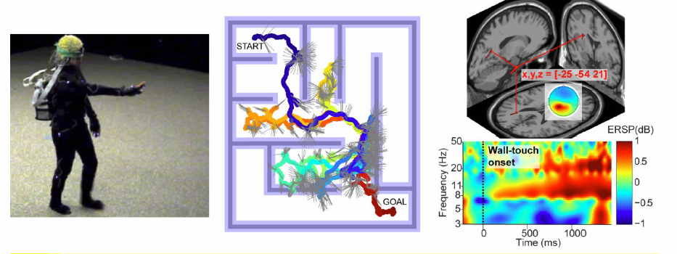
What Can be Done with LSL?
The Audio Maze:
A mixed-reality spatial navigation experiment. The experiment is controlled via LSL messaging while multi-modal data is simultaneously collected.
Miyakoshi, Makoto, et al. "The AudioMaze: An EEG and motion capture study of human spatial navigation in sparse augmented reality." European Journal of Neuroscience (2021).
Courtesy of Makoto Miyakoshi

Slide 20
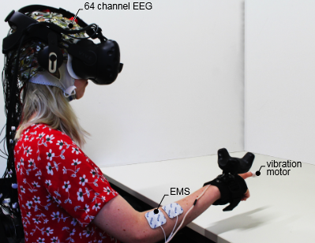
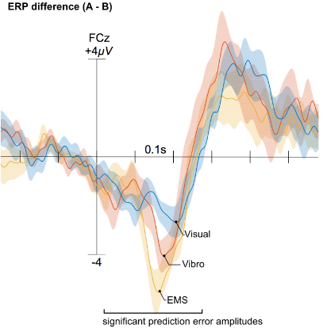
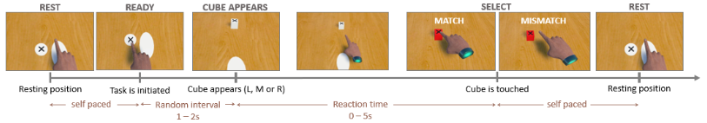
What Can be Done with LSL?
Evaluating Virtual Reality Experience:
A recent publication in CHI showing how EEG can inform haptic feedback in VR environments..
Gehrke, Lukas, et al. "Detecting visuo-haptic mismatches in virtual reality using the prediction error negativity of event-related brain potentials." Proceedings of the 2019 CHI Conference on Human Factors in Computing Systems. 2019.
Courtesy of Lukas Gehrke

Slide 21
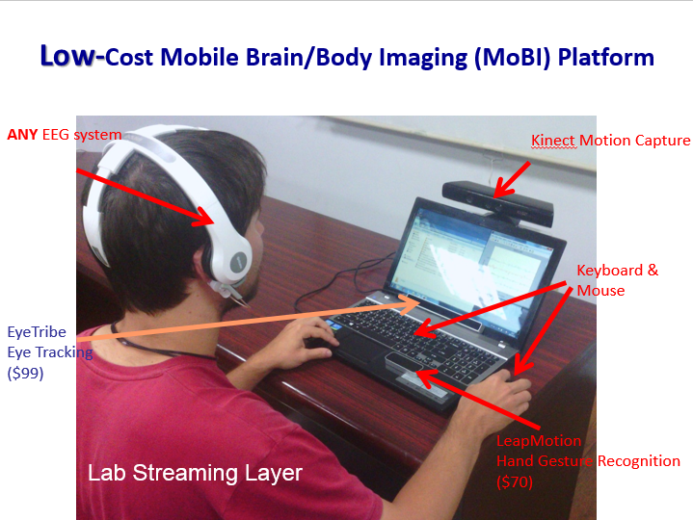
What Can be Done with LSL?
MoBI in a Box.
Many low-cost devices do not provide parallel ports, trigger inputs, or other hardware to use for synchronization. For outfitting (say) a classroom of experimental subjects a low-cost solution is often necessary. LSL provides a way to do this.
Courtesy of T. P. Jung

Slide 22
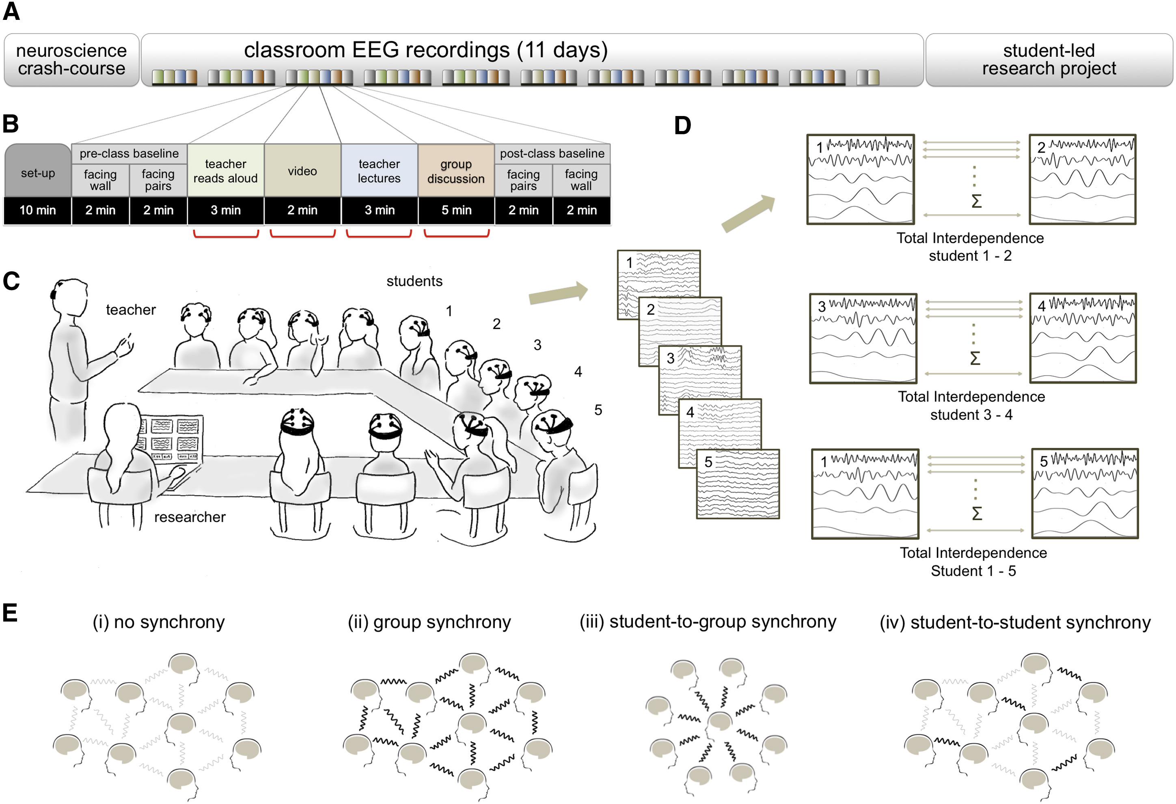
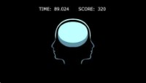
What Can be Done with LSL?
Brain-to-Brain Synchrony Tracks Real-World Dynamic Group Interactions in the Classroom.
Dikker, Suzanne, et al. "Brain-to-brain synchrony tracks real-world dynamic group interactions in the classroom." Current biology 27.9 (2017): 1375-1380.
Suzanne Dikker also uses real-time brain-to-brain measures in a number of projects:
https://www.suzannedikker.net/projects
Courtesy of Suzanne Dikker

